Slide 1
USING PORTFOLIOS TO DOCUMENT IMPACT
Tuesday, February 18, 2020

Slide 2
OUR AGENDA
The University of Arizona’s inclusive view of scholarship
Peer reviews and evaluation of teaching portfolios
Interpreting teacher course evaluations (TCEs)
Documenting outreach and service
Wrap-up and discussion

Slide 3
TODAY’S PRESENTERS
Ingrid Novodvorsky, Office of Instruction & Assessment
Lisa Elfring, Office of Instruction & Assessment
Andrea Romero, Vice Provost for Faculty Affairas

Slide 4
The Scholarship of Teaching & Learning at UA
Office of Instruction & Assessment
Building capacity for excellent teaching
Faculty Learning Communities
Collaborative Learning Spaces
Peer Review of Teaching Protocol
CUES SEMINAR SERIES
DISTINGUISHED FELLOWSHIPS
SYMPOSIA AND WORKSHOPS
TEACHING SCHOLAR CIRCLES

Slide 5
DOCUMENTING YOUR IMPACT
Develop an outcomes assessment plan to identify metrics that demonstrate your impact.
Consider benchmarks for the advancement of your teaching and outreach.
Use your Candidate Statement to frame your program of work with an inclusive vision.
Document your leadership and impact in Sections 6, 7, and 8 of your dossier.
Identify collaborators for your committee chair and/or head to solicit letters to offer testimony to your effective collaborators.

Slide 6
PEER REVIEW PROTOCOL & CRITERIA FOR EVALUATING TEACHING PORTFOLIOS
Ingrid Novodvorsky
Director, Teaching, Learning, & Assessment
Office of Instruction & Assessment

Slide 7
PEER REVIEW PROTOCOL
Section 7: Evaluation of Teaching & Teaching Portfolio
Classroom Observation Reports
On letterhead, dated, and signed by reviewer(s)
OIA Resource: Peer Review of Teaching Protocol

Slide 8
EVALUATING TEACHING PORTFOLIOS
Section 7: Evaluation of Teaching & Teaching Portfolio
Departmental Review
Assessment of Teaching Portfolio

Slide 9
EVALUATING TEACHING PORTFOLIOS
Criteria for Evaluation of Teaching Portfolios
Overall Content
Teaching Philosophy
Student Learning Outcomes
Active Learning Strategies
Student Assessment
Professional Development

Slide 10
INTERPRETING STUDENT COURSE SURVEYS (SCS)
Rebecca Pérez
Assistant Director, Instructional Data
Office of Instruction & Assessment

Slide 11
SCS CONSULTATION AND
SUPPORT SERVICES
Assistance accessing SCS and TCE reports in Uaccess Analytics
Consultation with departments or committees on adding questions for comprehensive performance appraisal planning
An additional 7 instructor/department questions may be added

Slide 12
SCS CONSULTATION AND
SUPPORT SERVICES
Assistance to faculty accessing and interpreting SCSs and TCEs
Adding additional questions targeting specific teaching elements
Contact
Rebecca Pérez, Assistant Director, Instructional Data
Office of Instruction and Assessment
rperez@email.arizona.edu and 626-0536

Slide 13
SCSs: ONLY ONE SOURCE
OF STUDENT FEEDBACK
SCSs/TCEs can provide formative student feedback to help assess a variety of teaching models, such as online classes, teams, TA’s, 7.5-week courses, and dynamically dated classes
SCS items focus on good teaching practices
The availability of SCS/TCE results to UA students and faculty by course and instructor increases accountability for effective teaching

Slide 14
SCS ITEMS
Likert-scale questions (Strongly agree-strongly disagree, 5 categories, no numerical values)
1. In this course, I was encouraged to participate through class activities, projects, and/or assignments.
2. This course expanded my knowledge and skills in this subject matter.
3. I was treated with respect in this course. (Unchanged from prior set of questions)
4. I was encouraged to analyze and/or apply the concepts and skills taught in this course.
5. The learning goals for this course were clear to me.
6. This course helped me to connect the concepts and skills we learned to the world around me.
7. I feel I learned the subject matter well enough to help another student in this course.
8. The course presentations, materials, procedures, and deadlines were clearly organized.
9. I regularly/frequently had the opportunity to ask questions about concepts and skills in this course.
10. I received feedback on my course work/assignments throughout the semester.
11. I received feedback on course work/assignments that helped me learn.
12. The course material and activities (D2L site, assigned readings, presentations, etc.) helped me learn in this course.

Slide 15
SCS ITEMS
Short-answer questions (no change to these)
1. What did you especially like about this course?
2. What suggestions would you make to improve the way this course is taught?
3. Please write any additional comments you may have below.

Slide 16
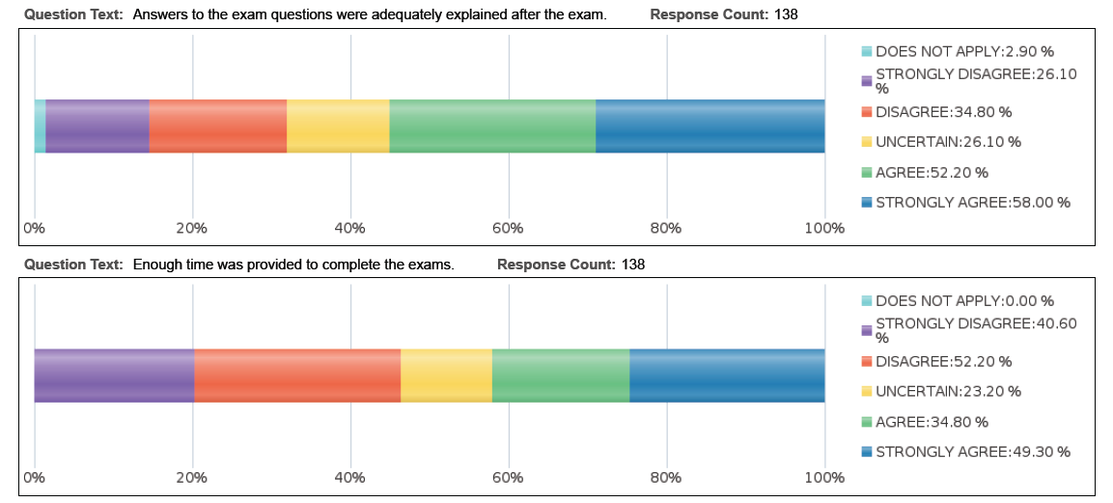
SCS Reports

Slide 17
OUR INCLUSIVE VIEW OF SCHOLARSHIP
The University values an inclusive view of scholarship in the recognition that knowledge is acquired and advanced through discovery, integration, application, and teaching. Given this perspective, promotion and tenure reviews, as detailed in the criteria of individual departments and colleges, will recognize original research contributions in peer-reviewed publications as well as integrative and applied forms of scholarship that involve cross-cutting collaborations with business and community partners, including translational research, commercialization activities, and patents.

Slide 18
Ernest Boyer’s Scholarship Reconsidered:
The scholarship of discovery includes investigations inquiries that generate new knowledge.
The scholarship of integration makes interdisciplinary connections to synthesize knowledge in new ways.
The scholarship of application is concerned with applying knowledge to social issues, sometimes to test theories and ground knowledge making.
The scholarship of teaching includes transforming and extending as well as transmitting knowledge.
The scholarship of engagement extends these forms of inquiry by collaborative inquiries on social issues.
Based on The Scholarship of Engagement,
Center for Experiential Learning, Loyola University

Slide 19
Evaluation
Workload Distribution
Unit Criteria for Promotion
Each unit has their own unique promotion guidelines that clarify what is considered of value within their field and what is typical in terms of workload, teaching, and service at each rank.
College Criteria for Promotion
Inclusive Scholarship
The University values an inclusive view of scholarship in the recognition that knowledge is acquired and advanced through discovery, integration, application, and teaching.
The University values collaboration among colleagues, both externally and internally, and the candidate's contributions to such collaborations will be considered in promotion reviews.
Depending on the assigned duties of individual candidates and the criteria of their departments and colleges, promotion reviews may consider original research contributions in peer-reviewed publications as well as integrative and applied forms of scholarship that involve cross-cutting collaborations with business and community partners, including translational research, commercialization activities, and patents.
https://facultyaffairs.arizona.edu/content/universitys-inclusive-view-scholarship

Slide 20
Publicly Engaged Scholarship
Publicly Engaged Research and Creative Activities
Type 1. Research—business, industry, commodity group funded. Sponsored research or inquiry supported through grants or contracts from businesses, industries, trade associations, or commodity groups (e.g., agricultural or natural resources groups) that generates new knowledge to address practical problems experienced by public or practitioner audiences.
Type 2. Research—nonprofit, foundation, government funded. Sponsored research or inquiry supported through grants or contracts from community-based organizations, nonprofit organizations, foundations, or government agencies that generates new knowledge to address practical problems experienced by public or practitioner audiences.
Type 3. Research—unfunded or intramurally funded applied research. Community-responsive or community-based research or inquiry that is not funded by a community partner but instead is pursued by faculty through intramural support or as financially unsupported research or inquiry.
Type 4. Creative activities. Original creations of literary, fine, performing, or applied arts and other expressions or activities of creative disciplines or fields that are made available to or generated in collaboration with a public (non-university) audience.

Slide 21
Publicly Engaged Service
Publicly Engaged Service
Type 10. Service—technical assistance, expert testimony, and legal advice. Provision of university-based knowledge or other scholarly advice through direct interaction with non-university clients who have requested assistance to address an issue or solve a problem.
Type 11. Service—co-curricular service-learning. Service-learning experiences that are not offered in conjunction with a credit-bearing course or academic program and do not include reflection on community practice or connections between content and the experience.
Type 12. Service—patient, clinical, and diagnostic services. Services offered to human and animal clients, with care provided by university faculty members or professional or graduate students, through hospitals, laboratories, and clinics.
Type 13. Service—advisory boards and other discipline-related service. Contributions of scholarly expertise made by faculty, staff, and students at the request of non-university audiences on an ad hoc or ongoing basis.
Publicly Engaged Commercialized Activities
Type 14. Commercialized activities. Translation of new knowledge generated by the university to the public through the commercialization of discoveries (e.g., technology transfer, licenses, copyrights, and some forms of economic development).
Doberneck, D. M., & Schweitzer, J. H. (2012). Disciplinary Variations in Faculty Expressions of Engaged Scholarship during Promotion and Tenure. IARSCLE Conference.

Slide 22
DOCUMENTING AND ASSESSING OUTREACH AND SERVICE
Service Porfolio

Slide 23
8: Service and Outreach Portfolio
This section is an option for P&T candidates, but all candidates should discuss the impact of their service in their candidate statement.
This section may be required for continuing status reviews that include educational outreach.
Candidates can use this section to document the impact of their leadership on outreach, service, and instructional programs.
In P&T reviews, these materials remain in departments.
However, if a candidate has provided significant leadership in developing outreach, curricular or other initiatives, he or she may request that the department head or committee chair send the Service and Outreach Portfolio to external reviewers.
Notes:
Andrea: Section 8 can be used to document impact in an administrative service leadership position. If serving as a director, department head and/or assistant or associate dean, please use this section to describe your leadership and impact in your position.

Slide 24
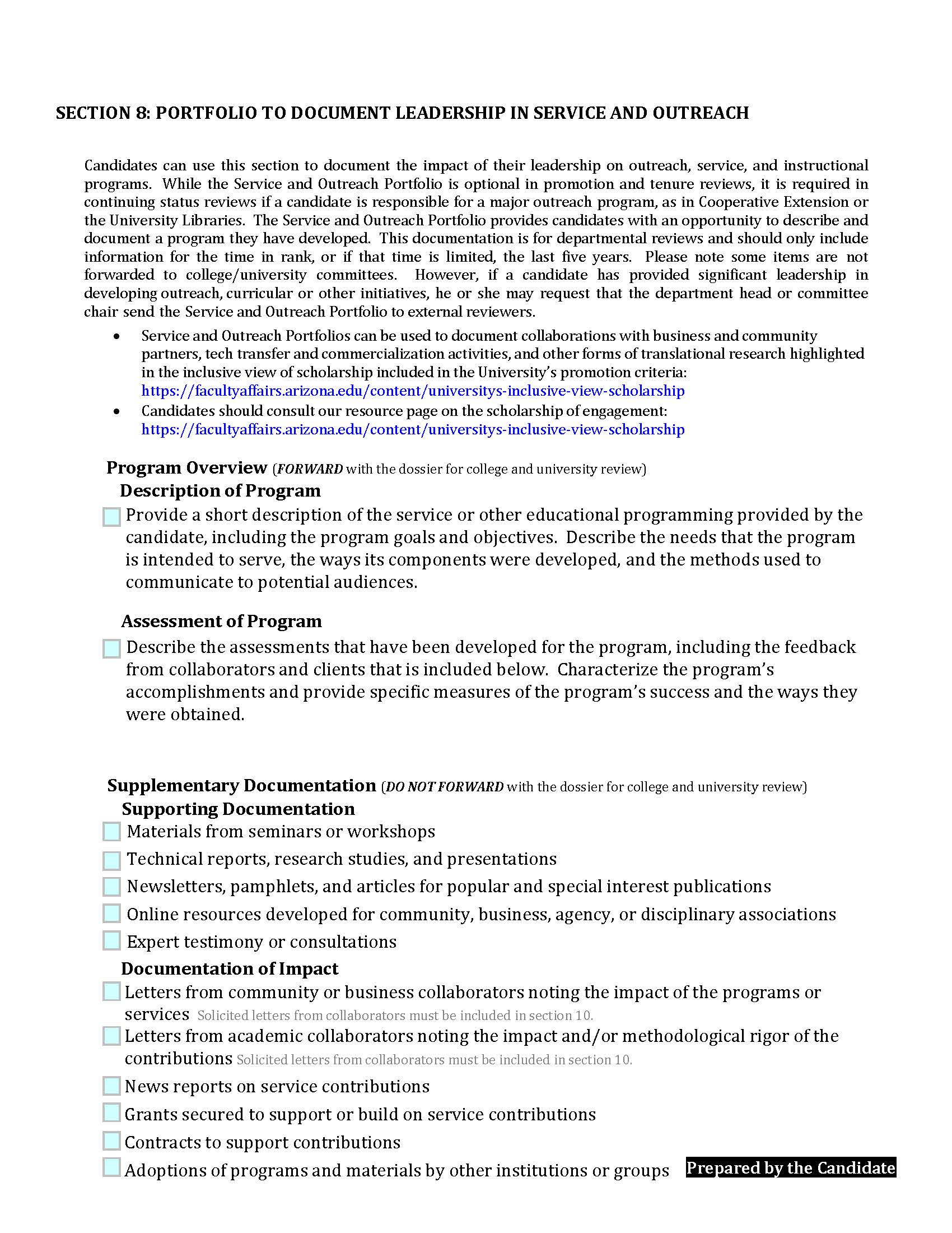

Slide 25
8: Service and Outreach Portfolio
Program Overview
Description of program
Goals & objectives
Needs intended to serve
How components were developed
Methods used to reach audiences
Assessment of program
Assessment of specific measures
Feedback from collaborators and clients
Accomplishments and demonstration of success
Notes:
Back to Tom Miller for this slide.

Slide 26
Supplementary Documentation
Supplementary Documentation
Supporting Docs
Expert testimony or consultations
On-line resources for community, business, agency, or disciplinary associations
Newsletters, pamphlets or articles for popular or special interest publications
Technical reports or materials

Slide 27
Impact
Documentation of Impact
Letters from community/business collaborators with emphasis on impact of programs
Letters from academic collaborators noting impact/rigor of contributions
News reports
Adoption of programs or materials by other institutions or groups

Slide 28
Documentation
Service and Outreach Portfolios can be used to document collaborations with business and community partners, tech transfer and commercialization activities, and other forms of translational research highlighted in the inclusive view of scholarship included in the University’s promotion criteria:
https://facultyaffairs.arizona.edu/content/universitys-inclusive-view-scholarship
Candidates should consult our resource page on the scholarship of engagement: https://facultyaffairs.arizona.edu/content/universitys-inclusive-view-scholarship

Slide 29
FOR FURTHER INFORMATION
https://facultyaffairs.arizona.edu/content/about-promotion

Slide 30
Purpose
Working together to expand human potential, explore new horizons and enrich life for all.
Mission
We will continuously improve how we educate and innovate so we can lead the way in developing disruptive problem-solvers capable of tackling our greatest challenges.
Vision
To create a world where human potential is realized and we’re all working together to create solutions to big problems so that life in our communities, in Arizona and on our planet can thrive.

Slide 31
CORE VALUES
INTEGRITY. Be honest, respectful and just.
COMPASSION. Choose to care.
EXPLORATION. Be insatiably curious.
ADAPTATION. Stay open-minded and eager for what’s next.
INCLUSION. We’re better together.
DETERMINATION. Bear Down.

Slide 32
EVALUATING FACULTY SERVICE
Serving on unit, college, and/or university committees
Serving in Faculty Senate
Chairing any committee (student, faculty, etc.)
Serving as a sponsor for student activities and groups, or volunteer organizations
Administrative assignments
Mentoring other faculty

Slide 33
EVALUATING PROFESSIONAL SERVICE
Activity in professional organizations
Consulting to organizations/corporations
Consulting to universities and colleges
Editing of journals
Organizing conferences or symposia
Serving on committees for federal or state government agencies or on boards

Slide 34
EVALUATING PUBLIC OR COMMUNITY SERVICE/OUTREACH
Participating in local, state, or national civic activities and organizations
Applying one’s academic expertise in the local, state, or national community
Working with elected officials

Slide 35
SOURCES OF EVALUATION INPUT
Faculty review committees
External peer reviews
Self-evaluation
Unit head assessment
Administrative supervisor
Faculty and staff colleagues
Awards and recognition
Statewide clientele, including public agencies, grower groups, etc.

Slide 36
The Faculty Affairs Team
Facultyaffairs.Arizona.edu

