Slide 1
USING TEACHING AND OUTREACH PORTFOLIOS TO DOCUMENT IMPACT
Monday, April 23, 2018

Slide 2
OUR AGENDA
The University of Arizona’s inclusive view of scholarship
Peer reviews and evaluation of teaching portfolios
Interpreting teacher course evaluations (TCEs)
Documenting outreach and service
Wrap-up and discussion

Slide 3
TODAY’S PRESENTERS
Ingrid Novodvorsky, Office of Instruction & Assessment
Rebecca Perez, Office of Instruction & Assessment
Dan McDonald, Norton School for Family and Consumer Sciences
Tannis Gibson, Fred Fox School of Music

Slide 4
OUR INCLUSIVE VIEW OF SCHOLARSHIP
The University values an inclusive view of scholarship in the recognition that knowledge is acquired and advanced through discovery, integration, application, and teaching. Given this perspective, promotion and tenure reviews, as detailed in the criteria of individual departments and colleges, will recognize original research contributions in peer-reviewed publications as well as integrative and applied forms of scholarship that involve cross-cutting collaborations with business and community partners, including translational research, commercialization activities, and patents.

Slide 5
Ernest Boyer’s Scholarship Reconsidered:
The scholarship of discovery includes investigations inquiries that generate new knowledge.
The scholarship of integration makes interdisciplinary connections to synthesize knowledge in new ways.
The scholarship of application is concerned with applying knowledge to social issues, sometimes to test theories and ground knowledge making.
The scholarship of teaching includes transforming and extending as well as transmitting knowledge.
The scholarship of engagement extends these forms of inquiry by collaborative inquiries on social issues.
Based on The Scholarship of Engagement,
Center for Experiential Learning, Loyola University

Slide 6
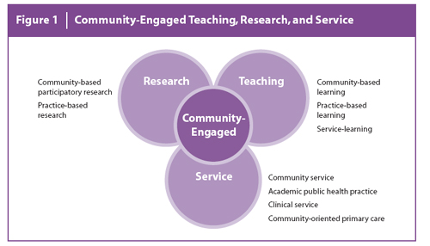
From The Scholarship of Engagement,
Center for Experiential Learning, Loyola University, Chicago

Slide 7
The Scholarship of Teaching & Learning at UA
Office of Instruction & Assessment
Building capacity for excellent teaching
Faculty Learning Communities
Collaborative Learning Spaces
Peer Review of Teaching Protocol
CUES SEMINAR SERIES
DISTINGUISHED FELLOWSHIPS
SYMPOSIA AND WORKSHOPS
TEACHING SCHOLAR CIRCLES

Slide 8
AN INCLUSIVE VIEW OF SCHOLARSHIP
Develop an outcomes assessment plan to identify metrics that demonstrate your impact.
Consider benchmarks for the advancement of your teaching and outreach.
Use your Candidate Statement to frame your program of work with an inclusive vision.
Document your leadership and impact in Sections 6, 7, and 8 of your dossier.
Identify collaborators for your committee chair and/or head to solicit letters to offer testimony to your effective collaborators.

Slide 9
PEER REVIEW PROTOCOL & CRITERIA FOR EVALUATING TEACHING PORTFOLIOS
Ingrid Novodvorsky
Director, Teaching, Learning, & Assessment
Office of Instruction & Assessment

Slide 10
PEER REVIEW PROTOCOL
Section 7: Evaluation of Teaching & Teaching Portfolio
Classroom Observation Reports
On letterhead, dated, and signed by reviewer(s)
OIA Resource: Peer Review of Teaching Protocol

Slide 11
EVALUATING TEACHING PORTFOLIOS
Section 7: Evaluation of Teaching & Teaching Portfolio
Departmental Review
Assessment of Teaching Portfolio

Slide 12
EVALUATING TEACHING PORTFOLIOS
Criteria for Evaluation of Teaching Portfolios
Overall Content
Teaching Philosophy
Student Learning Outcomes
Active Learning Strategies
Student Assessment
Professional Development

Slide 13
INTERPRETING TEACHER COURSE EVALUATIONS
Rebecca Perez
Assistant Director, Instructional Data
Office of Instruction & Assessment

Slide 14
TCE CONSULTATION AND
SUPPORT SERVICES
Assistance accessing TCE reports
Consultation with departments or committees on adding questions for comprehensive performance appraisal planning
An additional 7 instructor/department questions may be added

Slide 15
TCE CONSULTATION AND
SUPPORT SERVICES
Assistance to faculty accessing and interpreting TCEs
Adding additional questions targeting specific teaching elements
Contact
Rebecca Pérez, Assistant Director, Instructional Data
Office of Instruction and Assessment
rperez@email.arizona.edu and 626-0536

Slide 16
TCEs: ONLY ONE SOURCE
OF STUDENT INPUT
Instructor and course TCE core questions on teaching effectiveness provide comparisons of the instructor/course with appropriate comparison groups
Can be used to show trends over time
TCE and OIA provide consultation on interpreting and improving teaching effectiveness using TCE scales

Slide 17
TCEs: ONLY ONE SOURCE
OF STUDENT INPUT
TCEs can provide student feedback to help assess a variety of teaching models, such as online classes, teams, TA’s, 7.5-week courses, and dynamically dated classes
The availability of TCE results to UA students and faculty by course and instructor increases accountability for effective teaching

Slide 18
CORE QUESTIONS
The 11 core questions are:
What is your overall rating of this instructor’s teaching effectiveness?
What is your rating of this instructor compared with other instructors you have had?
What is your overall rating of this course?
I was treated with respect in this class
Rate the overall usefulness of in-class meeting time activities (e.g., lectures, discussions, teamwork, labs) in helping you achieve important course goals and objectives
Rate the overall usefulness of outside (not in class) assignments (homework, papers, reports, social projects, online work) in helping you achieve important course goals and objectives

Slide 19
CORE QUESTIONS
The 11 core questions are:
Rate the overall usefulness of assigned texts and readings (print or online) in helping you achieve important course goals and objectives
Rate the overall usefulness of online instructional tools and technology in this course (e.g., D2L, Blackboard, Panopto, Moodle, custom course websites and tools) in helping you achieve important course goals and objectives
How difficult was this course for you?
How much do you feel you have learned in this course?
Of the total hours you spent in this class, how many were valuable in advancing your education?

Slide 20
CORE QUESTIONS
There are also two comment questions:
What did you especially like about this course? (open text box)
What suggestions would you make to improve this course? (open text box)

Slide 21
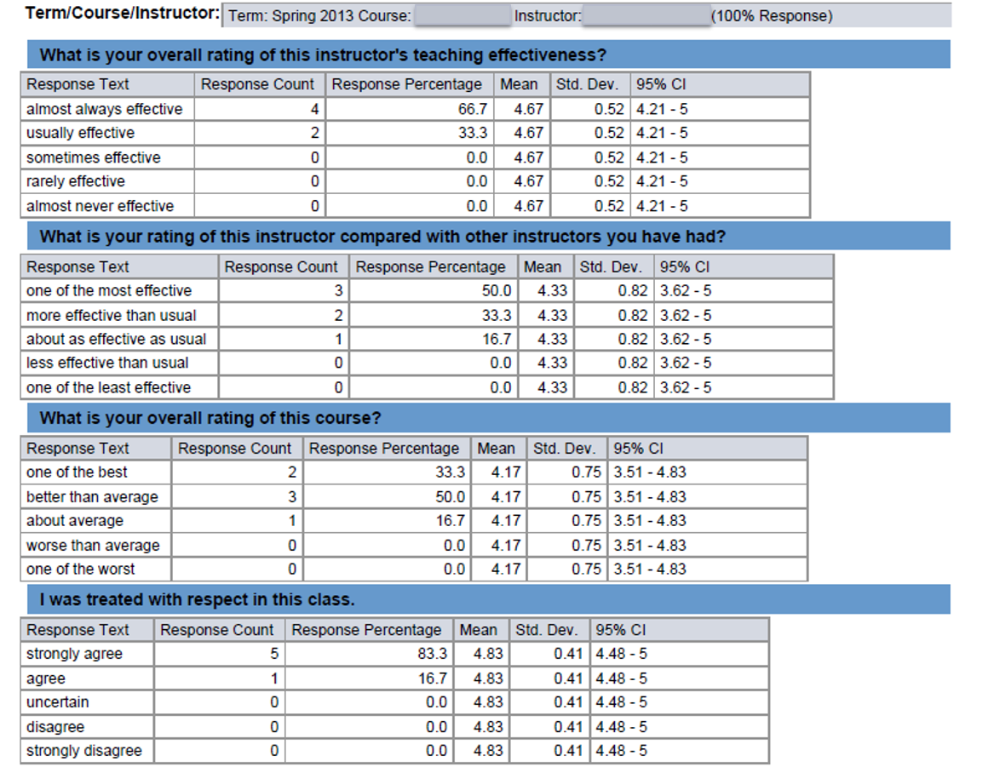
TCE STANDARD REPORT
Includes all statistical information for all questions
Provides response counts, means and standard deviations
Comments are available as a separate report

Slide 22
TCE COMPARISON GROUPS
Department class sections history
Lower division, upper division
Class size
Type: lecture, seminar, colloquium
Fall/spring semesters

Slide 23
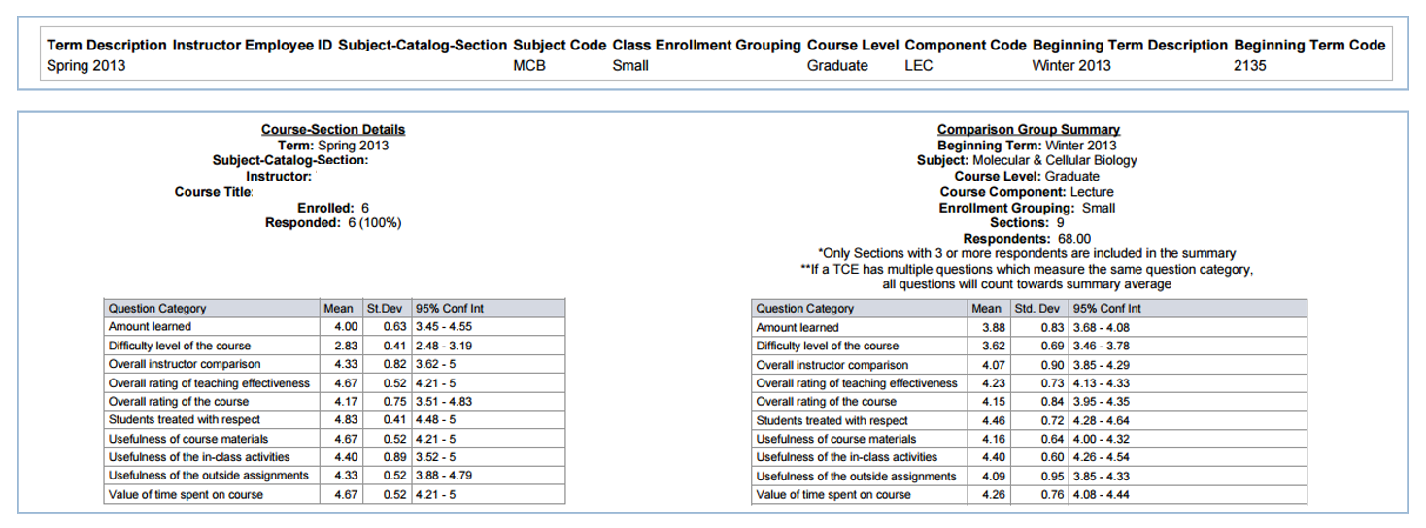
COMPARISON REPORT
Core items
Response distribution frequency and percentages
Item mean, standard deviation, 95% confidence interval
Comparison groups: mean, standard deviation, 95% confidence interval
How-to-Guide (tce.arizona.edu/content/reports)

Slide 24
DOCUMENTING AND ASSESSING OUTREACH AND SERVICE
Dan McDonald
Interim Director, Norton School of Family and Consumer Sciences

Slide 25
EXAMPLES OF SERVICE ACTIVITIES
Examples of activities for service with sources of evaluation input
https://cals.arizona.edu/about/workplace/promotion/guidelines-criteria/appendixa
To be used in conjunction with the position description in evaluating CALS faculty for promotion and/or tenure/continuing status
Faculty service
Professional service
Public or Community service/outreach

Slide 26
EVALUATING FACULTY SERVICE
Serving on unit, college, and/or university committees
Serving in Faculty Senate
Chairing any committee (student, faculty, etc.)
Serving as a sponsor for student activities and groups, or volunteer organizations
Administrative assignments
Mentoring other faculty

Slide 27
EVALUATING PROFESSIONAL SERVICE
Activity in professional organizations
Consulting to organizations/corporations
Consulting to universities and colleges
Editing of journals
Organizing conferences or symposia
Serving on committees for federal or state government agencies or on boards

Slide 28
EVALUATING PUBLIC OR COMMUNITY SERVICE/OUTREACH
Participating in local, state, or national civic activities and organizations
Applying one’s academic expertise in the local, state, or national community
Working with elected officials

Slide 29
SOURCES OF EVALUATION INPUT
Faculty review committees
External peer reviews
Self-evaluation
Unit head assessment
Administrative supervisor
Faculty and staff colleagues
Awards and recognition
Statewide clientele, including public agencies, grower groups, etc.

Slide 30
WRAP-UP AND DISCUSSION

Slide 31
FOR FURTHER INFORMATION
https://facultyaffairs.arizona.edu/content/about-promotion

